Slide 1
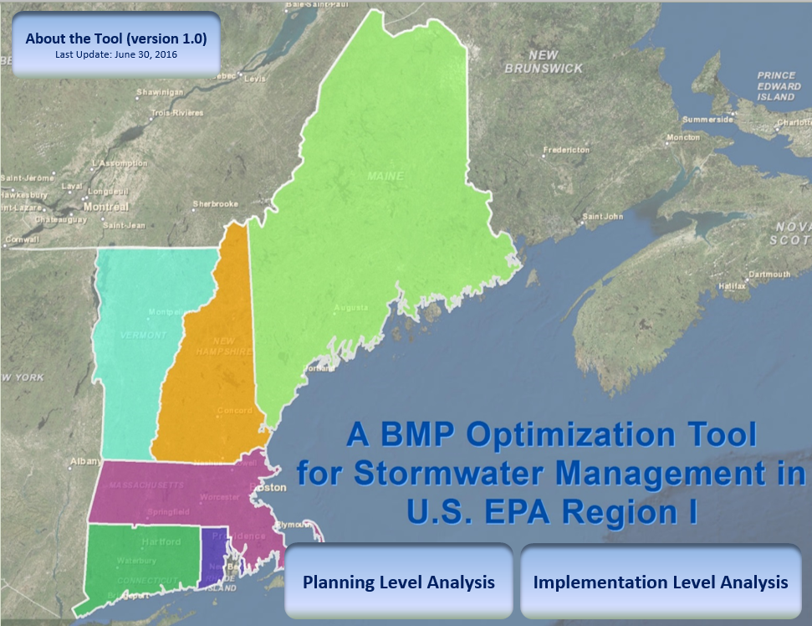
Opti-Tool: Introduction
Overview of the planning and implementation options

Slide 2
Presenter
Khalid Alvi
Environmental Engineer
Tetra Tech, Incorporated
Fairfax, Virginia
DISCLAIMER
The information presented in this webinar is intended solely to help parties understand the obligations and requirements imposed by MS4 permits. This webinar is not intended, and cannot be relied upon, to create any rights, substantive or procedural, enforceable by any party in litigation with the United States. EPA reserves the right to act at variance with the information presented in this webinar at any time without public notice.

Slide 3
Project Background
Small MS4 General Permit for MA and NH
Phosphorus reduction requirement to meet the Waste Load Allocations for the impaired watershed
Phosphorus Control Plan (PCP)
To measure compliance with its phosphorus reduction requirement under the permit
Opti-Tool
A tool to facilitate storm water engineers to developing Nutrient Management Plans such as PCP

Slide 4
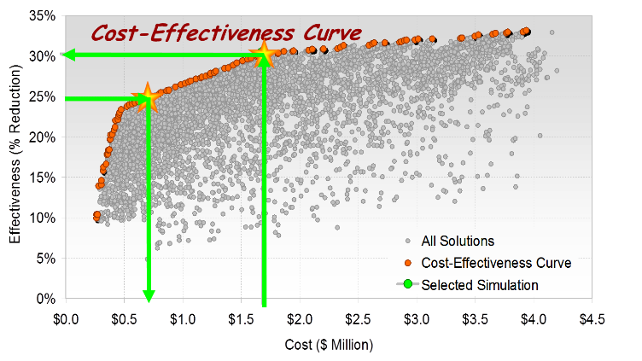
Project Background – cont.
Proven benefits of optimization techniques in stormwater management
Charles River watershed study
Practical needs by stormwater practitioners
BMP simulation
BMP optimization
Independent of ArcGIS
Simple to use

Slide 5
Opti-Tool
A spreadsheet-based BMP optimization tool
Planning Level Analysis (EPA Region 1 BMP Performance Curves)
Implementation Level Analysis (EPA SUSTAIN BMP Simulation and Optimization Engine)
Customized for EPA Region 1

Slide 6
Opti-Tool: Planning and Implementation Options
Excel Inputs
Excel Outputs
BMP Performance Curve
Excel Solver
Planning Level Input:
Target pollutant load reduction
Watershed land use area
BMP drainage area
Optimization method
Output Postprocessor:
Cost-effectiveness solution
Optimal management options
BMP size and cost
Treated impervious area
Implementation Level Input:
Watershed, land use, pollutants
Potential BMPs representation
BMP treated area
Management objective
SUSTAIN Optimization Engine
Input
Text File
Output Postprocessor:
Cost-effectiveness curve
Optimal management options
BMP type, size, and cost

Slide 7
Opti-Tool: Example Applications
Planning Level Analysis
Maximum possible load reduction for all feasible BMP opportunities
Watershed scale and/or site scale
Aggregated BMP representation (grouping same BMP types as one unit)
No BMP nesting (parallel BMPs)
Cost-effective single solution meeting the numeric target
Implementation Level Analysis
Optimal combination of different BMP types, sizes, and spatial locations
Watershed scale and/or site scale
Aggregated and/or distributed BMP representation
simple to complex BMP routing network (BMPs in parallel and/or in series)
Cost-effective solutions (CE-curve) for a range of load reduction targets

Slide 8
Opti-Tool: Region Specific Data
Precipitation Representation
Long-term hourly data at Logan airport (1992 – 2014)
Land Representation
Stormwater monitoring data to calibrate the buildup & washoff processes on impervious cover
Long-term landuse specific annual average load export rates
BMP Representation
University of New Hampshire Stormwater Center (UNHSC) BMP monitoring data to calibrate flow and pollutant loss mechanism in BMPs
Representative BMP cost information with scaling function

Slide 9
Opti-Tool: Precipitation Analysis
Data Used
12 weather stations from major urban areas
Represents climate regions in New England states
NCDC hourly weather records
Summary Results
Average annual precipitation varies from 34 in. to 46 in. with average value of 42.3 in.
Similar precipitation frequency distribution
48 percent of the events are < 0.1 inch
45 percent of the events are 0.1 to 1.0 inch
7 percent are > 1.0 inch
Boston Logan Airport station is representative

Slide 10
Opti-Tool: Buildup & Washoff Calibration
Data Used
National Stormwater Quality Database (NSQD)
Massachusetts and New Hampshire sites
100% impervious drainage areas
Storm events smaller or equal than 1 inch
Pollutants (TP and TN)
Buildup & Washoff Parameterization
Developed computer codes using GA algorithms to identify the parameter pattern that best fit the observed data
Calibrated 21 sets of parameters representing different initial conditions
Performed sensitivity analysis to identify the robust set of parameters

Slide 11
Buildup/Washoff: Calibration Plots for TP
Reference: Technical Memos.pdf

Slide 12
Opti-Tool: HRU Timeseries Development
Data Used
Selected robust set of pollutant buildup & washoff parameters in calibrated SWMM model
Regional representative landuse-based annual average pollutant load export rates (kg/ha/yr)
Hourly precipitation and PET timeseries (1992 to 2014)
Summary Results
Adjusted buildup parameters to match the simulated long-term annual average pollutant loading rate (kg/ha/yr)
Compared the simulated EMC distribution against the observed EMC distribution for impervious land use types
Developed HRU hourly timeseries for flow, TP, TN, and TSS

Slide 13
Reference: Technical Memos.pdf

Slide 14
Opti-Tool: HRU Types
Commercial/Industrial
High-Density Residential
Medium-Density Residential
Low Density Residential
Highway
Open Land
Forest
Agriculture
Forest Pervious
Agriculture Pervious
Developed Land Pervious – Hydrologic Soil Group A
Developed Land Pervious – Hydrologic Soil Group B
Developed Land Pervious – Hydrologic Soil Group C
Developed Land Pervious – Hydrologic Soil Group C/D
Developed Land Pervious – Hydrologic Soil Group D

Slide 15
Opti-Tool: BMP Calibration
Data Used
BMP design specifications (from the UNHSC)
BMP monitoring data: flow and water quality (from the UNHSC)
BMP Parameterization
Developed SUSTAIN models
Calibrated water quality parameters (1st order decay and underdrain removal rate)
Compared simulated BMP hydrograph and water quality performance against the observed BMP hydrograph and observed BMP efficiency
Calibrated structural stormwater BMPs for flow, TP, TN, and TSS

Slide 16
Bioretention: Hydrology Calibration

Slide 17
Opti-Tool: BMP Performance Curve
Data Used
Calibrated SUSTAIN model
Calibrated hourly HRUs timeseries (1992 to 2014)
BMP Simulation
Run BMP scenarios for a range of storage capacity and estimated the pollutant load reductions
Developed BMP performance curve (pollutant load reduction vs storage capacity)
Developed long-term cumulative pollutant load and runoff volume reduction performances for several categories of structural stormwater controls

Slide 19
Opti-Tool: BMP Types
Bio-filtration
Enhanced Bio-filtration with Internal Storage Reservoir
Dry Pond
Grass Swale
Gravel Wetland
Infiltration Basin
Infiltration Chambers
Infiltration Trench
Porous Pavement
Sand Filter
Wet Pond

Slide 20
Opti-Tool: BMP Cost Function
BMP Type | Cost ($/ft³) – 2016
Bioretention | $ 15.46
Dry Pond | $ 6.8
Enhanced Bioretention | $ 15.61
Infiltration Basin | $ 6.24
Infiltration Chamber | $ 67.85
Infiltration Trench | $ 12.49
Porous Pavement (Porous Asphalt Pavement) | $ 5.32
Porous Pavement (Pervious Concrete) | $ 18.07
Sand Filter | $ 17.94
Subsurface Gravel Wetland | $ 8.78
Wet Pond | $ 6.8
Combination of the Charles River Watershed Association and UNHSC costs estimates
Modified capital cost assessment (includes a fixed percentage for Design and Contingency Costs)
Maintenance hours (from the UNHSC)
Reference: Technical Memos.pdf

Slide 21

Opti-Tool: Interfaces

Slide 22
Planning Level: Two Approaches
BMP Storage Capacity
Evaluate the BMP performance for a design criterion (e.g., capture 1 inch storm size)
Evaluate the changes in water quality benefits as the BMP sizes are changed
Identify the most cost-effective BMP storage capacity that meets the target pollutant load reduction
BMP Drainage Area
Determine how much impervious drainage area would require treatment if specified BMP design capacities were selected
Identify the extent of impervious area to be treated that can provide the target pollutant load reduction
In this approach, both the BMP storage capacity and BMP cost are fixed

Slide 23
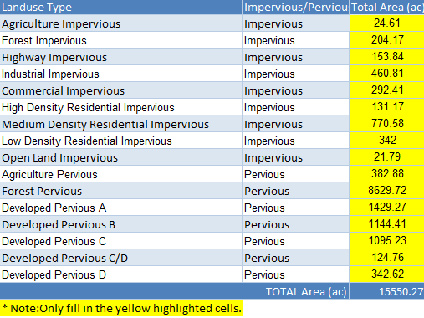
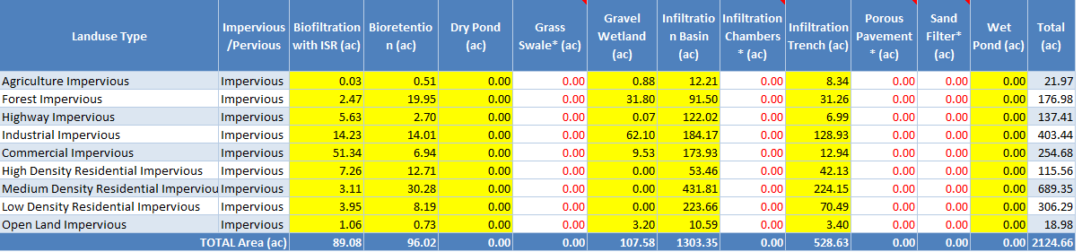
Opti-Tool: Planning Level

Slide 24
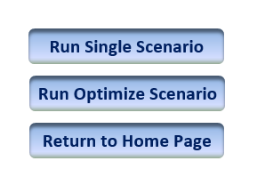
Opti-Tool: Planning Level – cont.

Slide 25
Opti-Tool: Interfaces

Slide 26
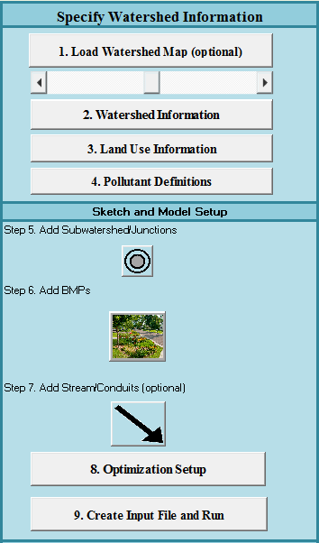
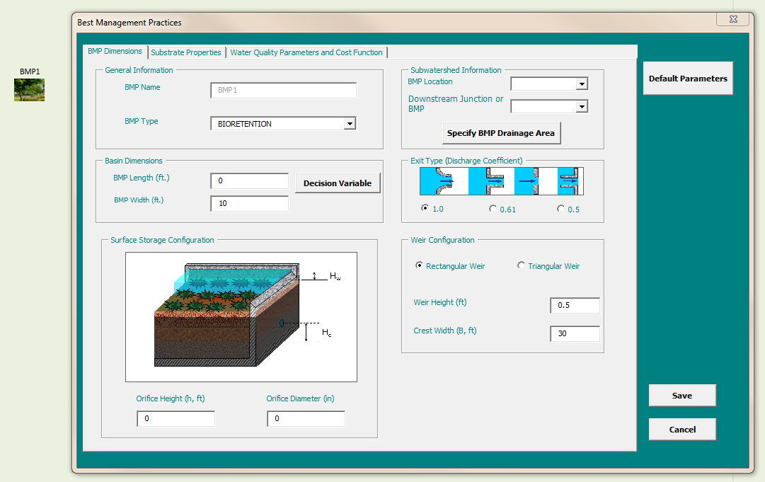
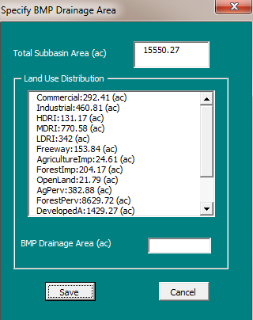
Opti-Tool: Implementation Level

Slide 27
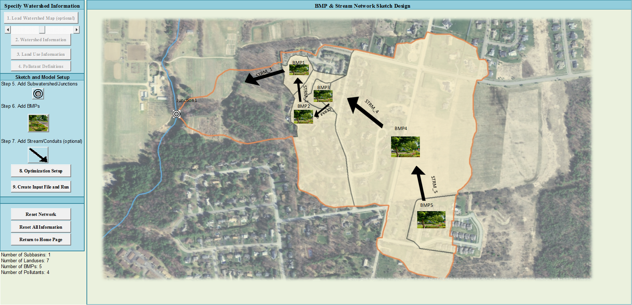
Opti-Tool: Implementation Level – cont.

Slide 28
Opti-Tool: View Results
Cost $84.53 million to meet 52.1% average annual TP load reduction target
Cost saving of $47.5 million (56%) by lowering 10% of the numeric target (42.1%)

Slide 29
Benefits of Opti-Tool
Accessible to all users with Microsoft Excel 2013 software
Represents actual regional precipitation conditions
Incorporates best available information on regional stormwater urban runoff nutrient quality for estimating the long-term surface runoff and pollutant loadings from different land uses
Incorporates best available information for estimating long-term cumulative nutrient load and runoff volume reduction performances for structural stormwater controls
Uses information which is being shared with other regional tool developers to promote the use of consistent and high quality data

Slide 30
Benefits of Opti-Tool – cont.
Incorporates representative stormwater control units cost information with scaling function to account for specific conditions and development density
Includes flexibility to conduct either watershed planning level or detailed site specific design-level analyses
Performs optimization analyses to determine most cost-effective selection of structural stormwater controls for achieving pollutant loading and runoff flow related reduction targets
Results are consistent with loading rates and BMP performance documented in the EPA Region 1 MS4 permits

Slide 31
Flexible to Adopt for Other Regions
Develop local weather data
Hourly precipitation (in./hr)
Daily temperature (min and max)
Run SWMM model (provided in the installation package)
Local weather data (input)
SWMM hourly HRU timeseries (output)
Run HRU utility tool (provided in the installation package)
SWMM hourly HRU timeseries (input)
Opti-Tool hourly HRU timeseries (output)
Update default data (provided in the installation package)
HRU timeseries and local BMP cost function (optional)

Slide 32
Feedback and Other Presentations
Questions or comments?
Mark Voorhees (voorhees.mark@epa.gov)
Links to other presentations
https://www.epa.gov/npdes/npdes-stormwater-webcasts

